Slide 1
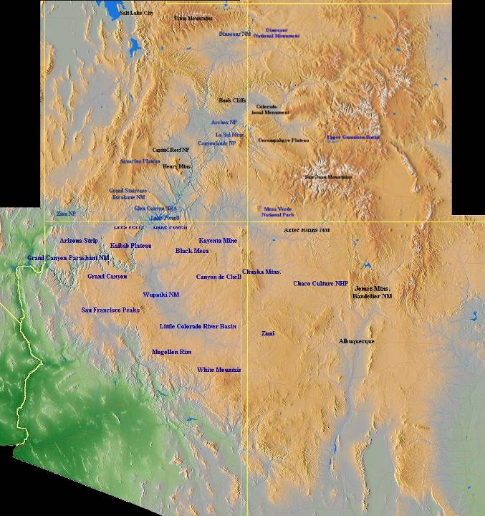
DCM strata in the Colorado Plateau
Canyonlands
Grand Canyon
Notes:
Of the eight National Parks in the Colorado Plateau, only the Grand Canyon and Canyonlands expose a section of Paleozoic strata worthy of our study of Divergent Continental Margins.

Slide 2
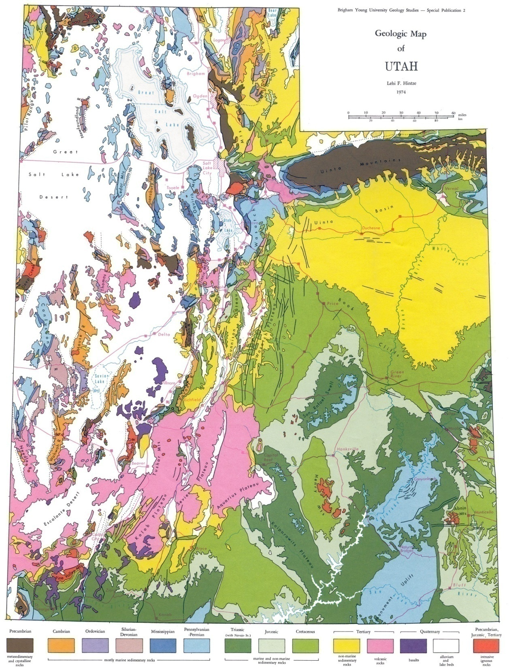
Canyonlands National Park
Notes:
This lesson will focus on Canyonlands National Park which as you can see on this geologic map of Utah …

Slide 3
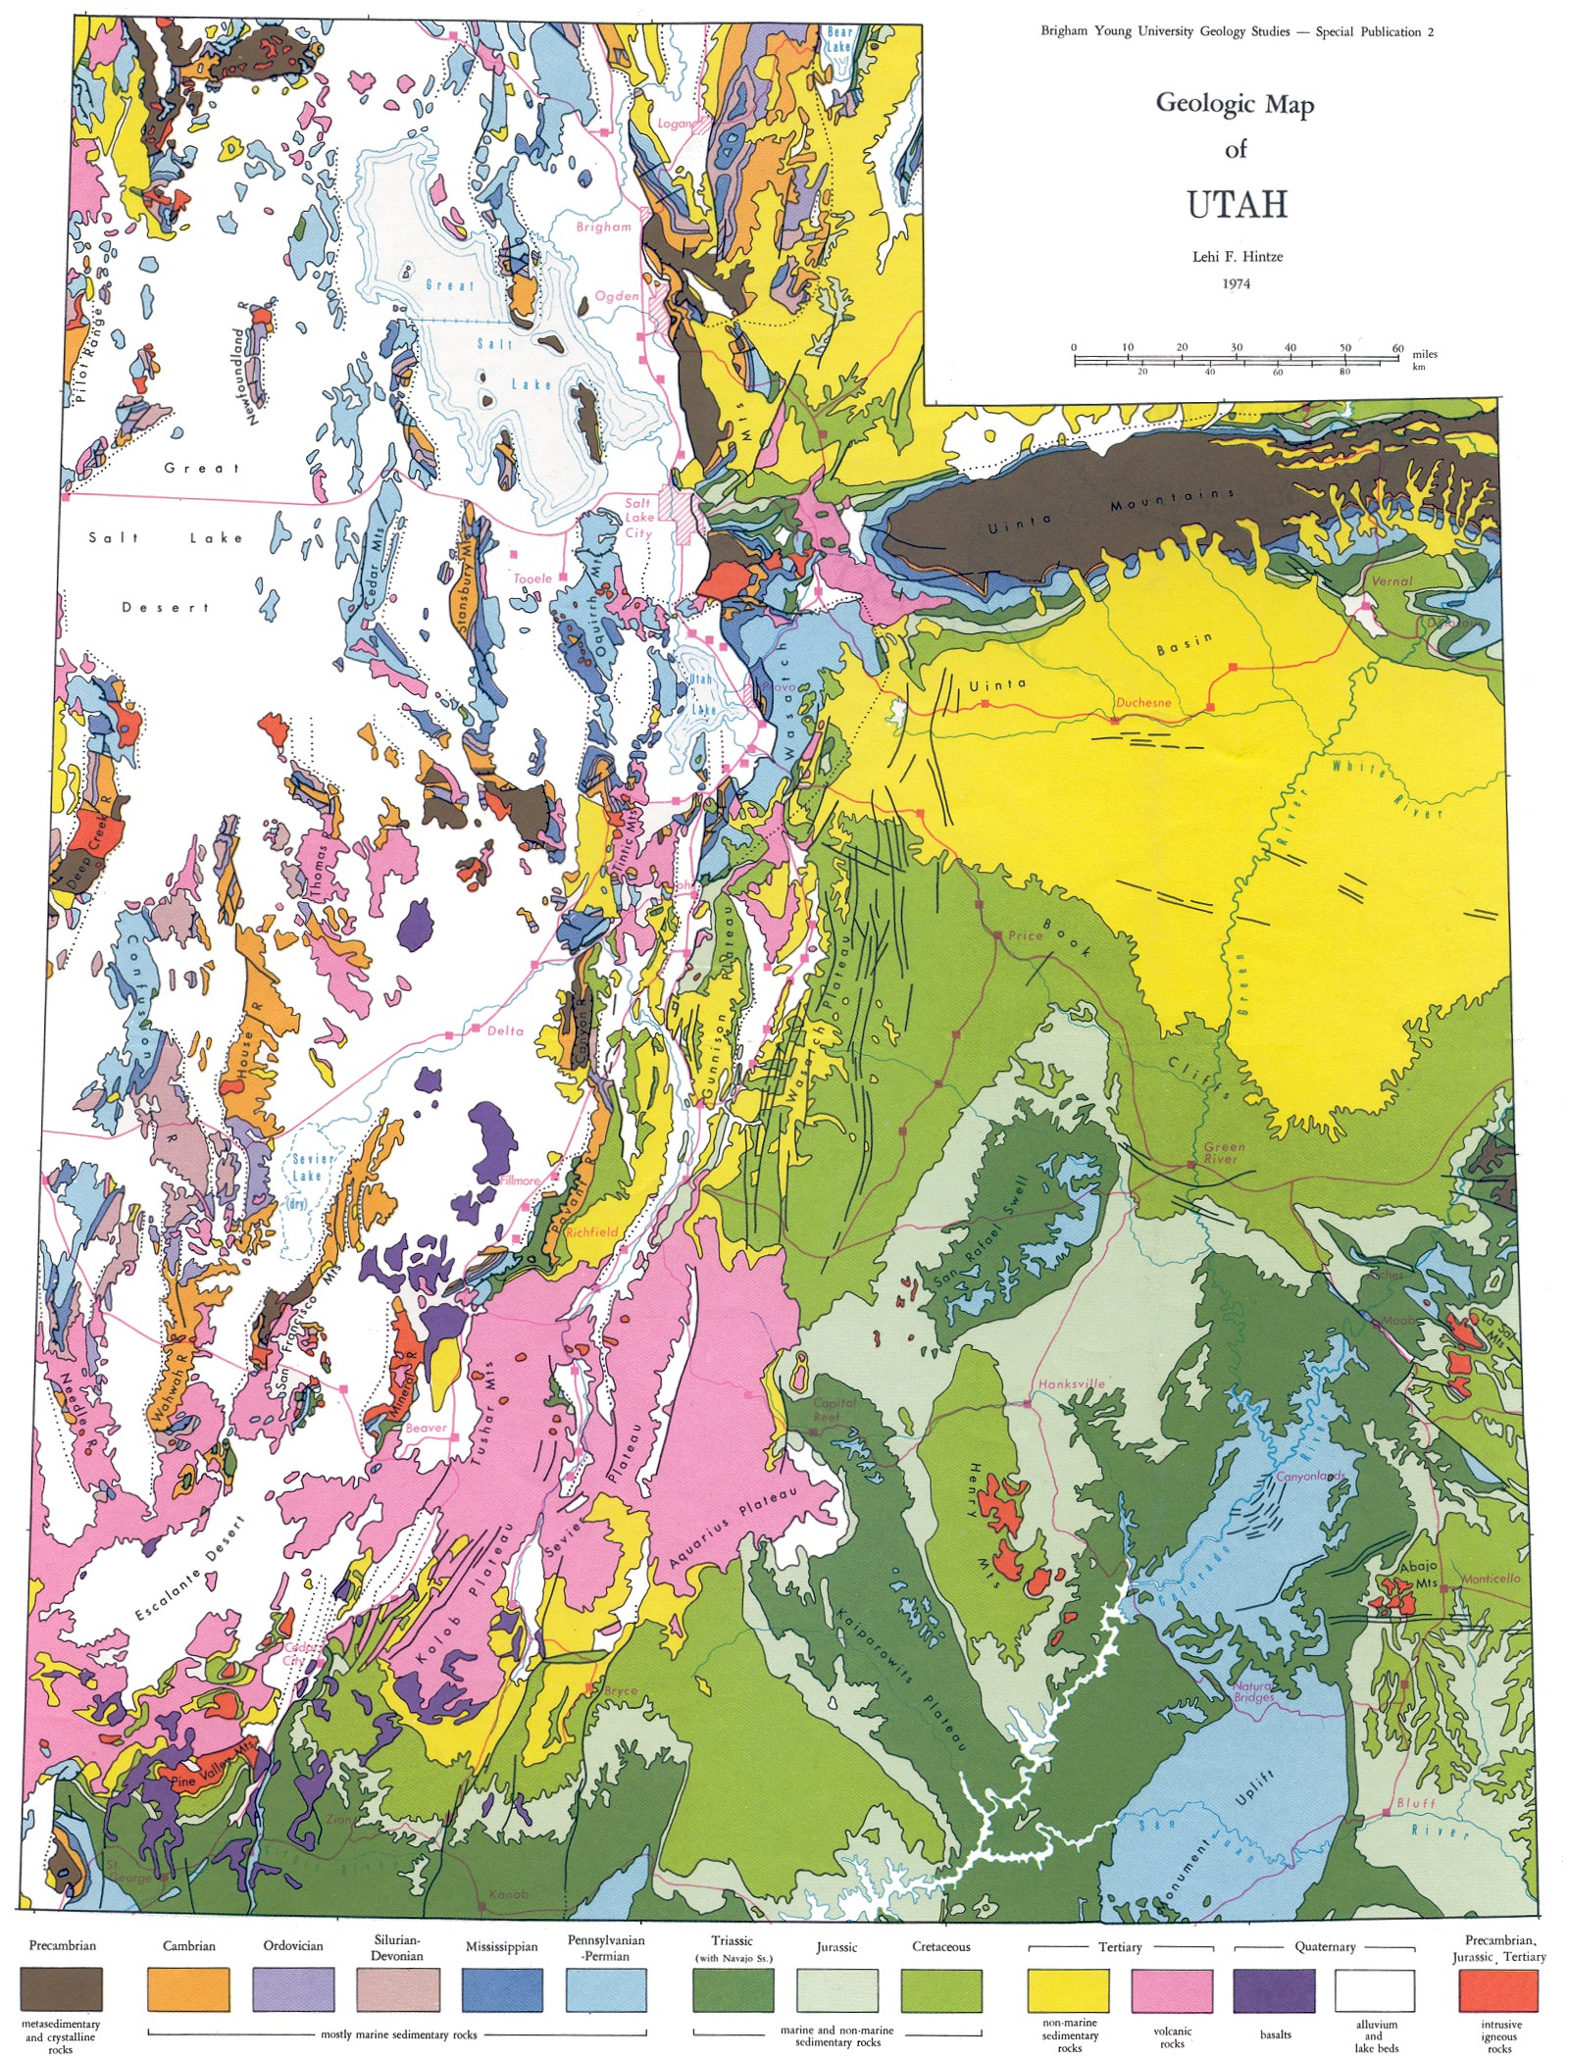
Canyonlands National Park
Notes:
... Lies within an area of southeastern Utah that exposes mostly Pennsylvanian and Permian rocks.

Slide 4
Arches
Bryce
Zion
Notes:
Zion, Bryce Canyon, and Arches National Parks expose mostly Mesozoic strata, during which time western North America was undergoing too much mountain building to be considered a DCM.

Slide 5
Canyonlands National Park
Monument Uplift
Notes:
Part of the reason why Paleozoic rocks are exposed in Canyonlands National Park, rather than the younger Mesozoic strata exposed elsewhere in the region, is due to the fact that Canyonlands is located on the edge of the Monument Uplift - a broad, Laramide arch that caused most of the Mesozoic strata to be denuded in the area.

Slide 6
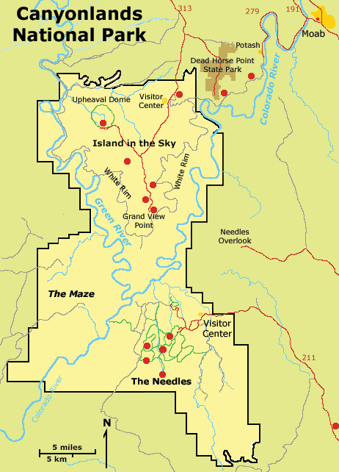
Notes:
Canyonlands’ proximity to the confluence of the Colorado River and its largest tributary, the Green River, also played a role. Like the Grand Canyon, erosion rates where high enough to uncover the older Paleozoic strata.

Slide 7
Upper Paleozoic exposed
Canyonlands
Entire Paleozoic exposed
Grand Canyon
Notes:
But because Canyonlands National Park is located more towards the center of the Colorado Plateau than the Grand Canyon, erosion was not as severe and only exposed upper Paleozoic strata of the Pennsylvanian and Permian periods.

Slide 8
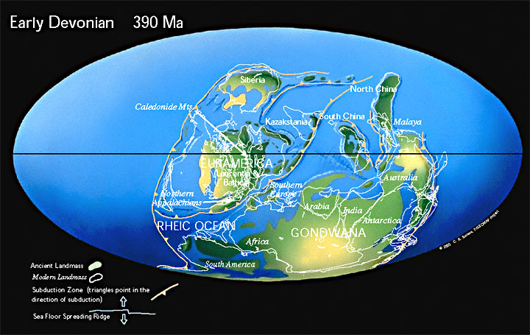
Rheic Ocean
Notes:
Let’s take a look at the paleotectonic situation that led to the formation the Pennsylvanian and Permian strata in Canyonlands. The key interaction here is the closing of the Rheic Ocean as South America collides with North America.

Slide 9
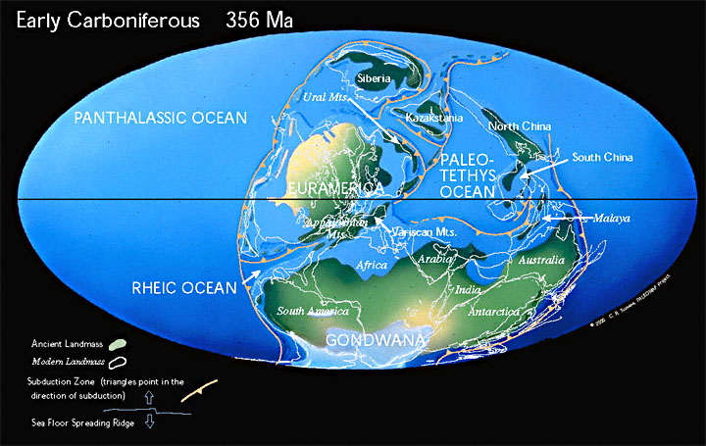
Notes:
Notice the reduced size of the Rheic Ocean as we enter the Mississippian.

Slide 10
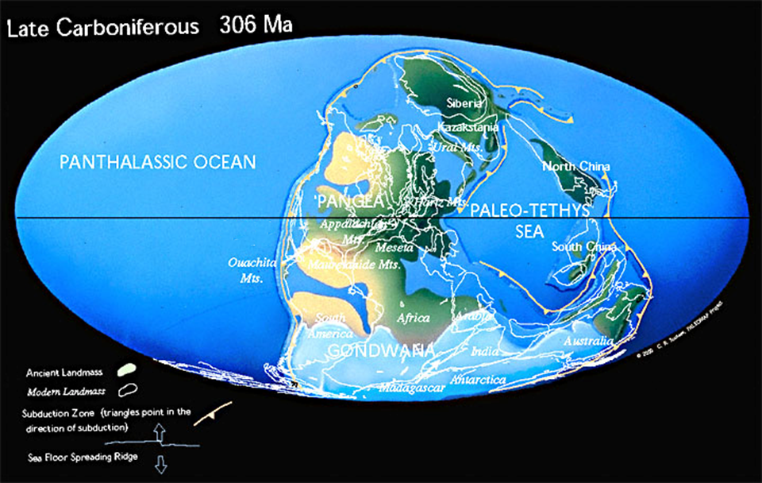
Ancestral Rockies
Notes:
By the Pennsylvanian period, North and South America have collided and uplift has begun in the Ancestral Rockies.

Slide 11
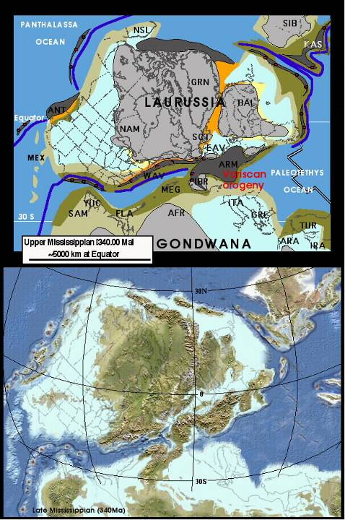
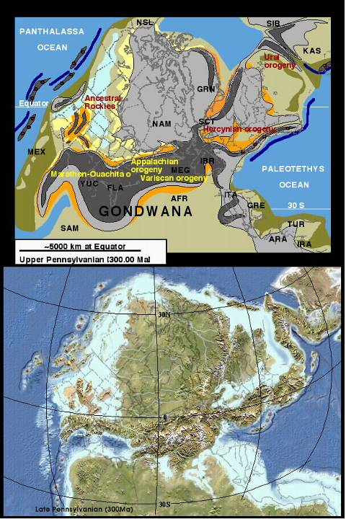
Ancestral Rockies
Notes:
Enlarging North America a bit we can see that the Ancestral Rockies consisted of several ranges and basins surrounded by the shallow seas of the old divergent continental margin. This is the situation that made Canyonlands and nearby Arches National Parks special, because it is within one of these basins that the shallow seas where so completely surrounded by ranges that they evaporated and deposited a thick layer of salt.

Slide 12
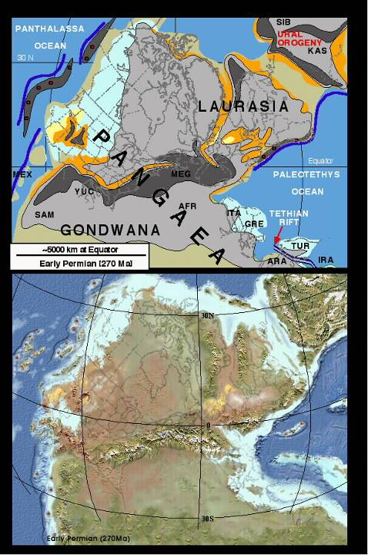
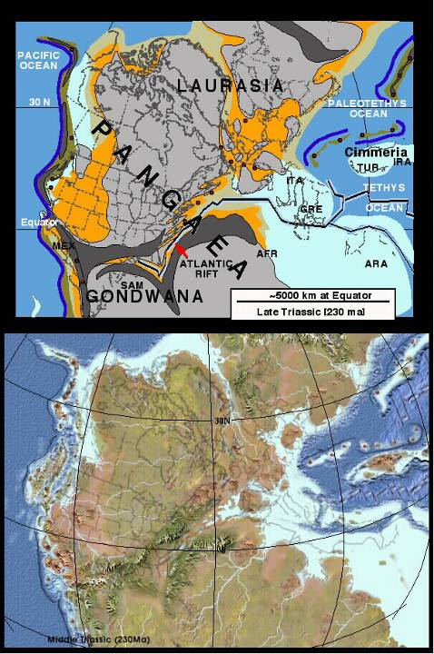
Clastic sediment
Notes:
Throughout the Permian these ranges eroded. By the Triassic, clastic sediments derived from the erosion of the Ancestral Rockies had completely buried the salt deposits.

Slide 13
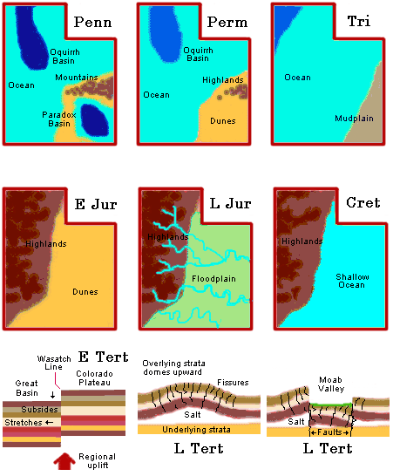
Notes:
The Pennsylvanian basin in which the salt deposited is known as the Paradox Basin. You can see that it becomes covered up by sand dunes in the Permian. Recall that this was the same time that sand dunes stretched from Mexico to Montana, forming the Coconino Sandstone in the Grand Canyon. By the Triassic, the Ancestral Rockies had been worn down and the Canyonlands region was covered by a low elevation mud plain. Other sediments will deposit during the Jurassic and Cretaceous periods, but like the Grand Canyon, the Mesozoic section will be denuded from much of the park following Laramide uplift.

Slide 14
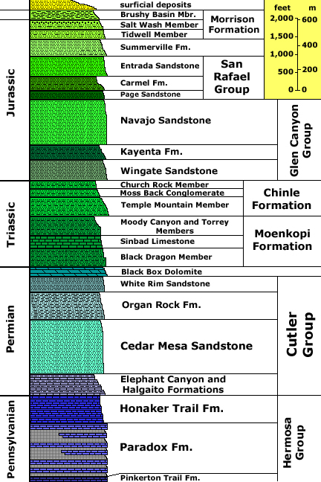
Units mostly eroded
Units exposed
Notes:
So the main units exposed in Canyonlands National Park are the Paradox Formation – a sequence of salt, gypsum, shale and limestone; the Honaker Trail Formation – composed of shallow marine sediments; and the Cutler Group – a complex series of sandstones and shales that deposited in a variety of depositional environments as shorelines oscillated and interfingered with deposits on beach dunes, sand bars and alluvial fans.

Slide 15
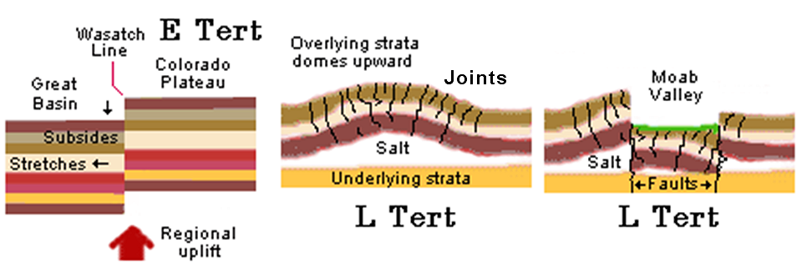
Salt Anticline
Salt Valley
Notes:
Sometime after the Laramide uplift of the Colorado Plateau but before the weight of the Mesozoic section was removed by erosion, salt anticlines formed. Salt will basically flow towards the surface because the density of salt is very low, and under pressure, it becomes rather plastic. The rising salt anticlines folded and fractured the brittle overlying rocks and joint systems developed parallel to the axis of the anticline. These provided conduits for groundwater flow, which dissolved the salt and thereby removed the support holding up the overlying rocks. Salt valleys formed where the overlying rocks collapsed along faults roughly parallel to the joint systems.

Slide 16
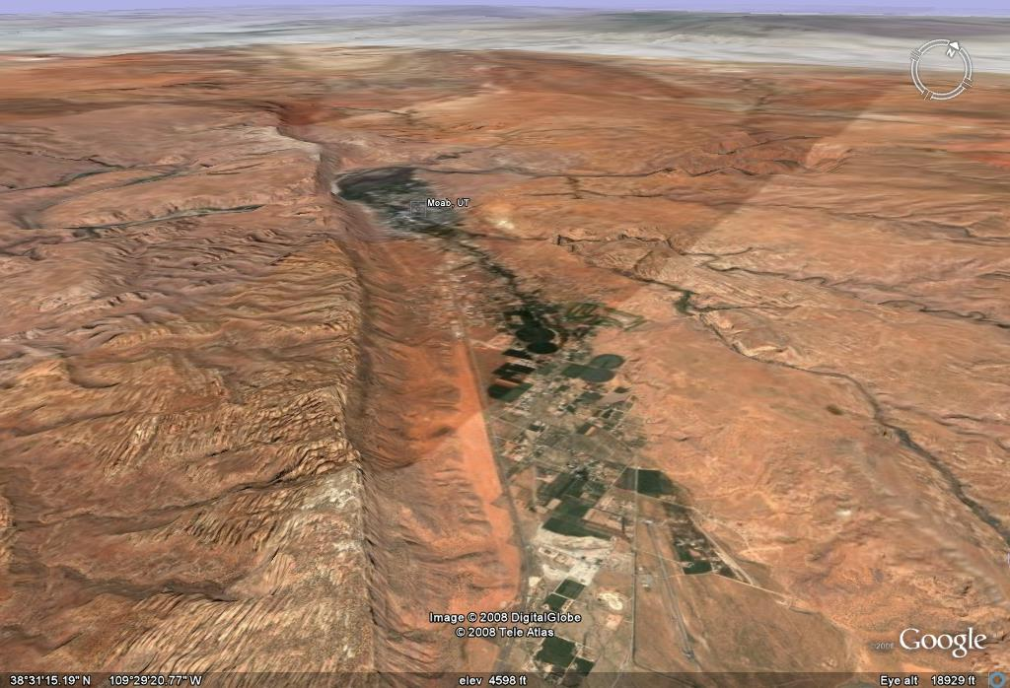
Moab
salt valley
Notes:
Although nearby Moab, Utah lies in a large salt valley, …

Slide 17
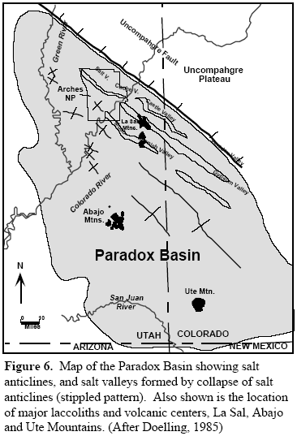
Salt valleys
Notes:
… and there are several other salt valleys nearby (shown in yellow), none of these lies within the boundaries of Canyonlands.

Slide 18
Salt anticlines
Notes:
Nonetheless, several salt anticlines do lie beneath the strata of Canyonlands which are important because they fractured the overlying rocks along joint systems …

Slide 19
Laramide compression
Notes:
… that generally follow the northwest to southeast trend of the salt anticlines and salt valleys produced by Laramide compression.

Slide 20
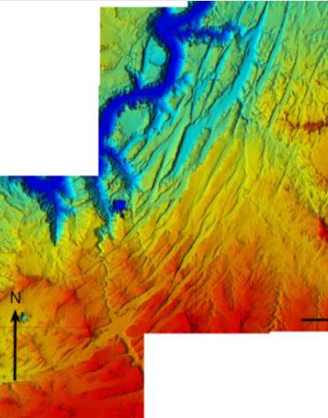
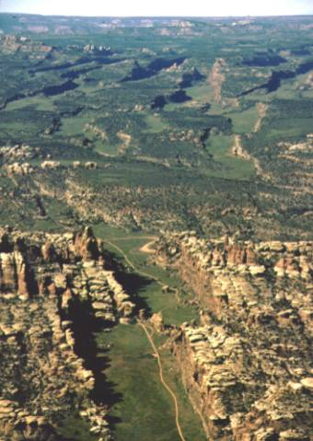
Colorado River
Salt Grabens
Notes:
Although salt valleys do not occur in Canyonlands, related landforms known as a salt grabens do. Notice that the salt grabens do not share the same orientation as the salt anticlines and salt valleys. They parallel the Colorado River instead.

Slide 21
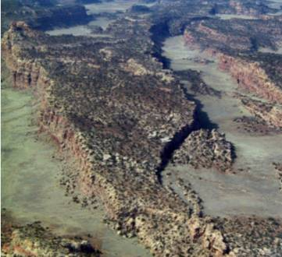
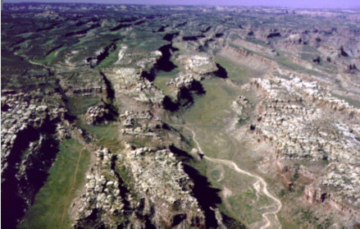
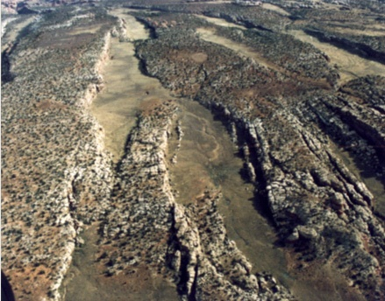
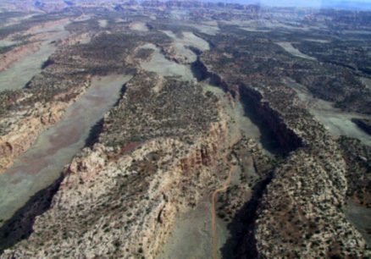
Salt Grabens
Notes:
Another important difference is that the transition from higher to lower elevations is far more abrupt with salt grabens and that the landscape appears decidedly two-tiered. Moreover, notice that the borders of these landforms often fit together as if they where pulled apart.

Slide 22
Salt Grabens
Notes:
Indeed, the landscape bears a striking resemblance to stretch marks!

Slide 23
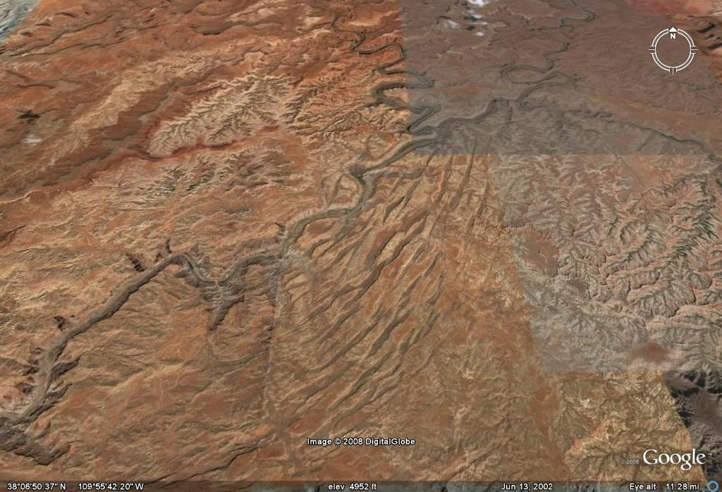
Green River
Colorado River
salt grabens
Notes:
Taking all these features into account and noting that the grabens occur just downstream from the confluence of the Green and Colorado Rivers, but on only one side, geologists came up with a convincing theory for salt graben origin.

Slide 24
Monument Uplift
Notes:
First, the Laramide “Monument Uplift” gently tilted the Canyonlands’ strata to the northwest,…

Slide 25
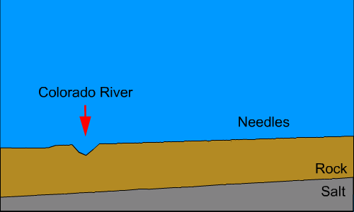
NW
SE
Future graben area
Notes:
… which, much later will end up being from the graben area towards the Colorado River.

Slide 26
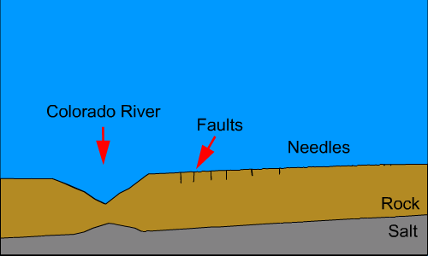
Notes:
Energized by water freshly added from the Green River, the Colorado River rapidly down-cut towards the underlying salt deposits, thereby removing lateral support from the rocks up-dip from the river and initiating a series of faults parallel to the canyon.

Slide 27
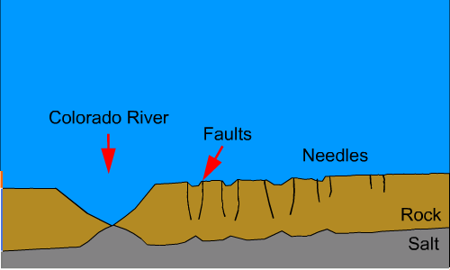
Notes:
As erosion continues, rock is removed whose weight is effectively “holding-down” the underlying salt, so the plastic, low density salt flows upward, hastening the time when the Colorado will make contact with the salt. Meanwhile the faults deepen as more lateral support is taken away.

Slide 28
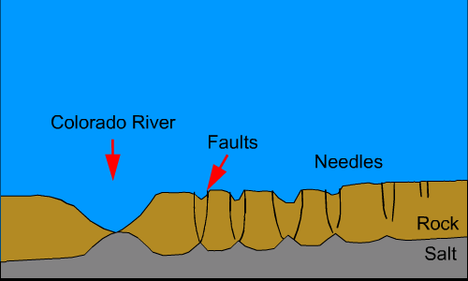
Notes:
Once the Colorado River begins to dissolve the salt, rock begins to slide rapidly over the plastic salt towards the river. Since the Colorado only made contact with the salt a scant 100,000 years ago, …

Slide 29
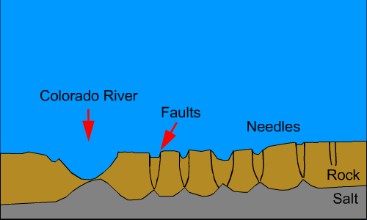
Notes:
…the grabens are far too young for erosion to have smoothed their features appreciably.

Slide 30
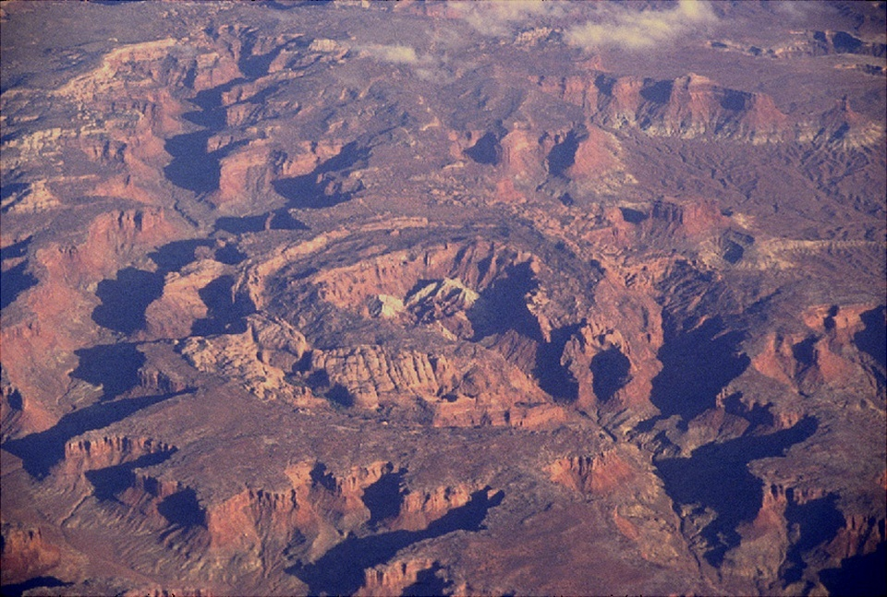
Upheaval Dome
Notes:
Upheaval Dome is another Canyonlands landform which has been attributed to the action of salt.

Slide 31
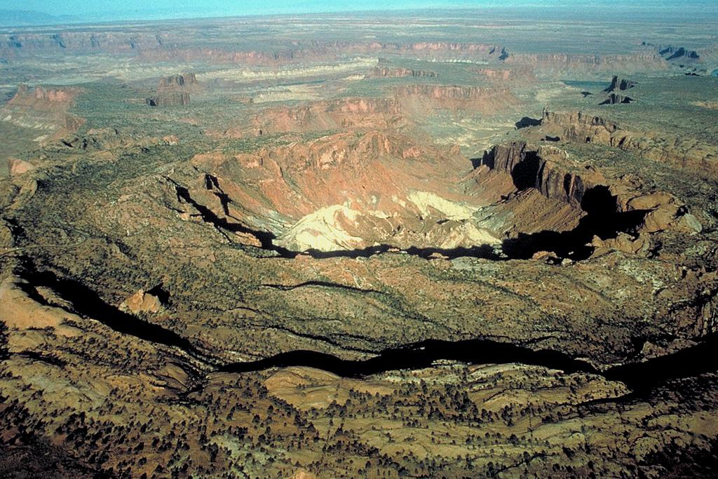
White Rim Sandstone
Notes:
The conspicuous light-colored rock in the center is the White Rim Sandstone.

Slide 32
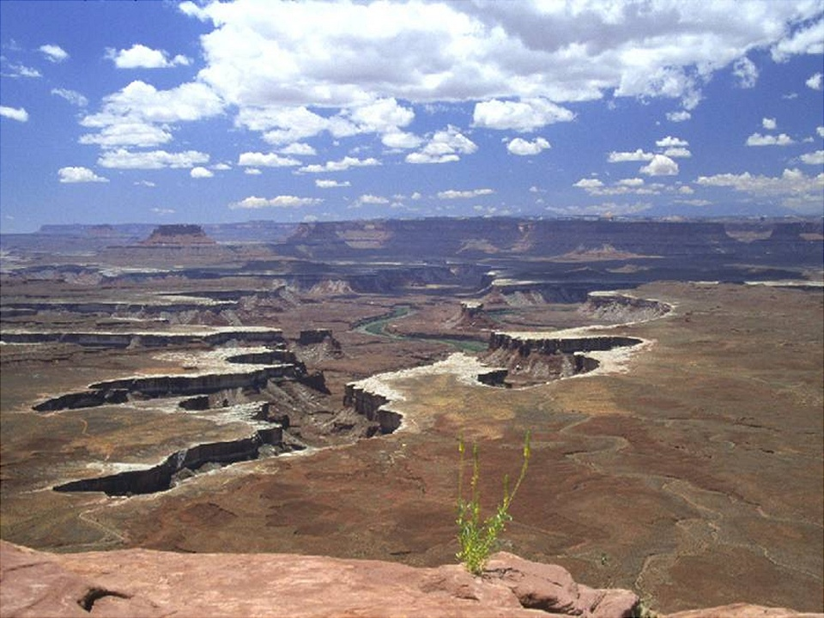
Green River
White Rim Sandstone
Notes:
So named for its common occurrence in the park around the rim of both the Green and Colorado River Canyons.

Slide 33
Organ Rock Shale
(Permian)
Moenkopi Formation
(Triassic)
Notes:
It makes for a handy marker bed usually separating the Paleozoic from the Mesozoic.

Slide 34
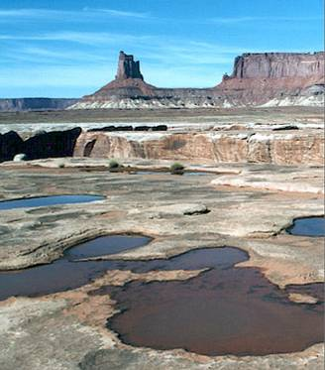
Mesozoic
White Rim Sandstone
(Permian)
Notes:
Although the Mesozoic section has been eroded from most of the Canyonlands, significant thicknesses remain in the northern part of the park …

Slide 35
Notes:
… in a wedge-shaped district between the Green and Colorado Rivers known as “Island in the Sky”. This is also where Upheaval Dome is located.

Slide 36
Units exposed in Upheaval Dome
Notes:
The Mesozoic rocks exposed in Upheaval Dome…

Slide 37
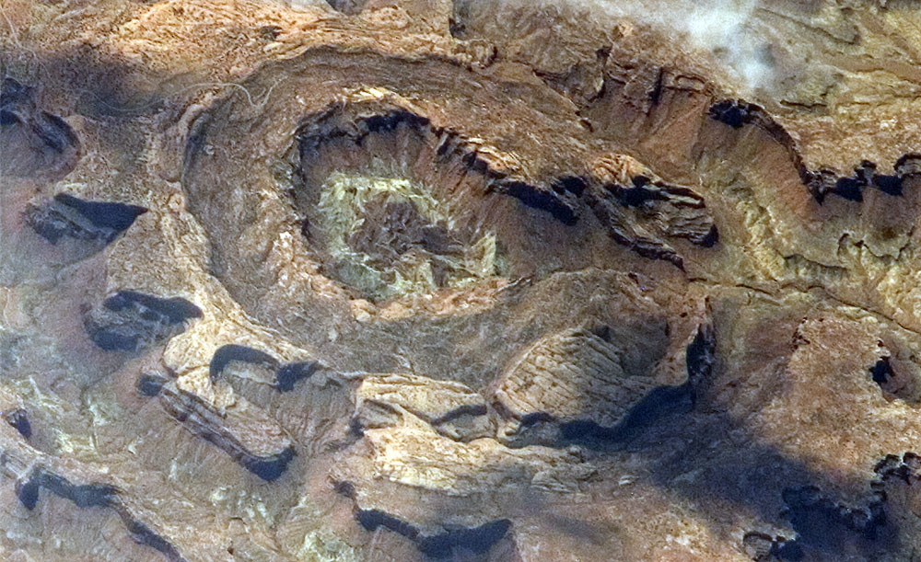
Notes:
…are arranged in a ring like structure with progressively older units in the center …

Slide 38
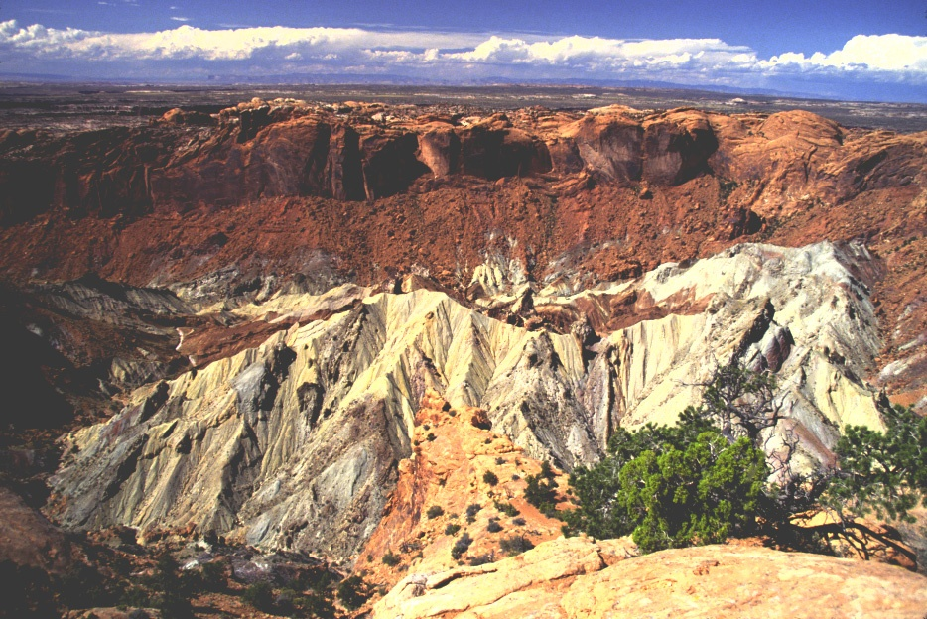
Permian White Rim Sandstone in core of dome
Notes:
… where the Permian rocks are exposed.

Slide 39
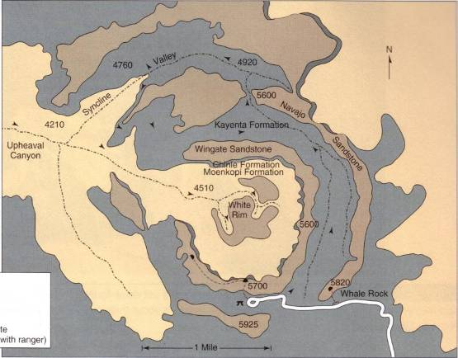
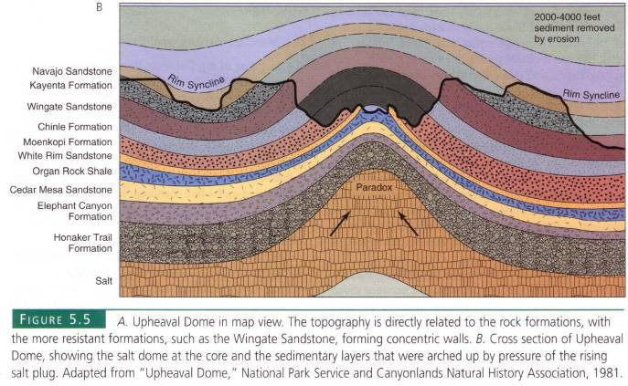
Salt Diapir
Notes:
The dome has long been interpreted as originating from uplift associated with the intrusion of a salt diapir from the Paradox salt unit below.

Slide 40
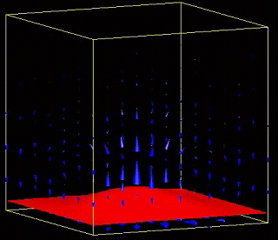
Diapir
Notes:
Driven upwards by their relative buoyancy…

Slide 41
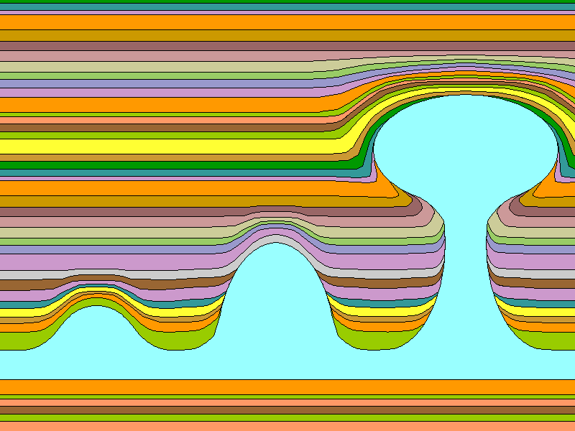
Salt Diapirs
Notes:
…salt diapirs routinely fold and ultimately pierce the overlying strata.

Slide 42
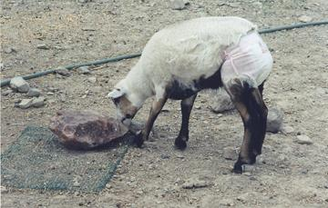
Salt
Diaper
Notes:
Salt diapers are something entirely different. One can find most anything on Google Image search!

Slide 43
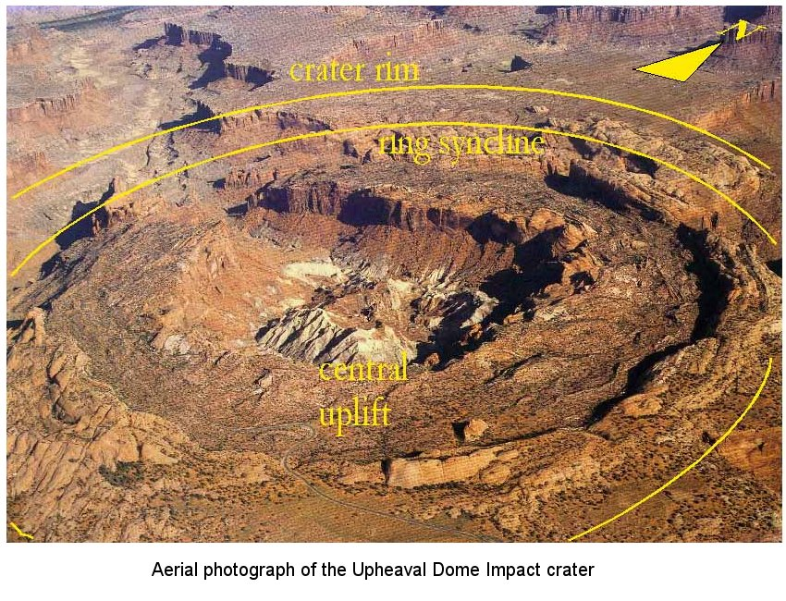
Notes:
A gentle syncline (downward fold) surrounds the central uplift. This arrangement …

Slide 44
Notes:
…is not unlike that produced by the impact of a drop of water onto water.

Slide 45
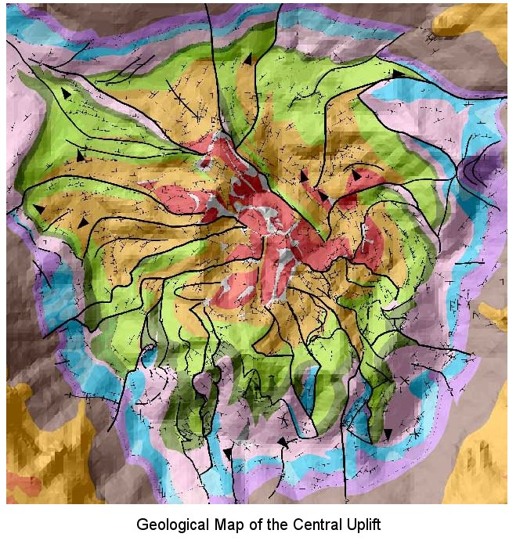
Notes:
Impact origin is also supported by the complex fracture patterns in the central uplift, …

Slide 46
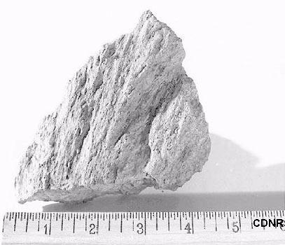
Shatter cone
Notes:
… shatter cones in the White Rim Sandstone, ….

Slide 47
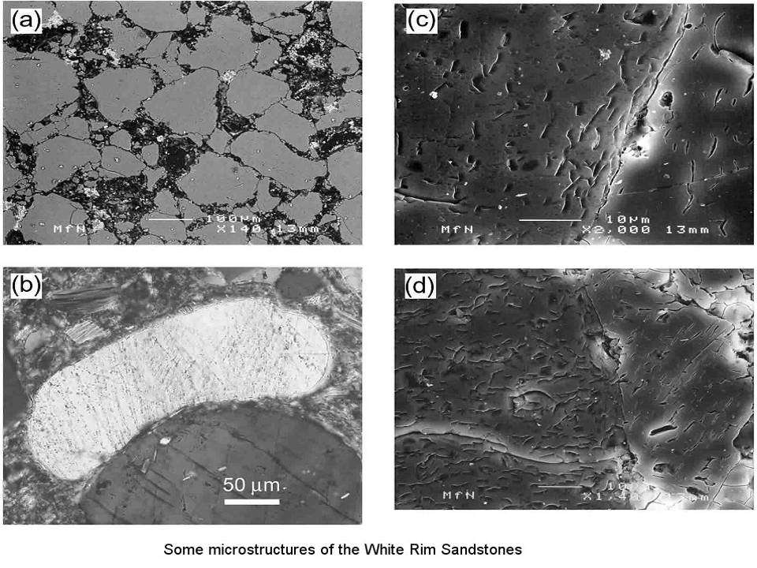
Notes:
… and shock-fractured quartz grains. Despite the compelling indirect evidence pointing towards meteorite impact forming Upheaval Dome, the idea has not been universally accepted, because no meteorites have ever been found in the area. Of course they could have been eroded, but the idea that a meteorite would strike an area where so many salt-induced structures occur, just seems a little too coincidental for proponents of the salt diapir theory. Personally, I think the two hypotheses are mutually compatible. If a meteorite hit an area underlain by salt, the salt would rise diapirically towards the impact site because the pressure on the salt would be lower there due to the removal of all the rock that was blasted away by the impact.

